Slide 1
Data Structures & Algorithms
Mohammad Shahid Qureshi

Slide 2
My Introduction
Mohammad Shahid Qureshi
Email
Shahid.qureshi@nu.edu.pk
Office
Room# 113, 1st floor, EE block

Slide 3
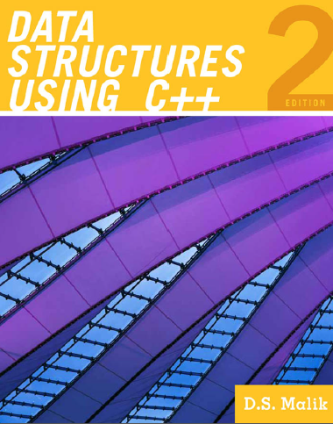
Text book
Data Structures using C++
D.S. Malik
But other books will also be concerned

Slide 4
Grading
18% - 6 programming assignments (individual)
12% - Quizzes
20% - Midterm
Final – 50%

Slide 5
Join Google Classroom
https://classroom.google.com/c/Mzg3NjI4NjE1NTM1?cjc=t2np33h
Or use the following code
t2np33h

Slide 6
Definition
A data structure is a way to store and organize data (in the RAM) in order to facilitate access and modifications
No single data structure works well for all purposes, and so it is important to know the strengths and limitations of several of them

Slide 7
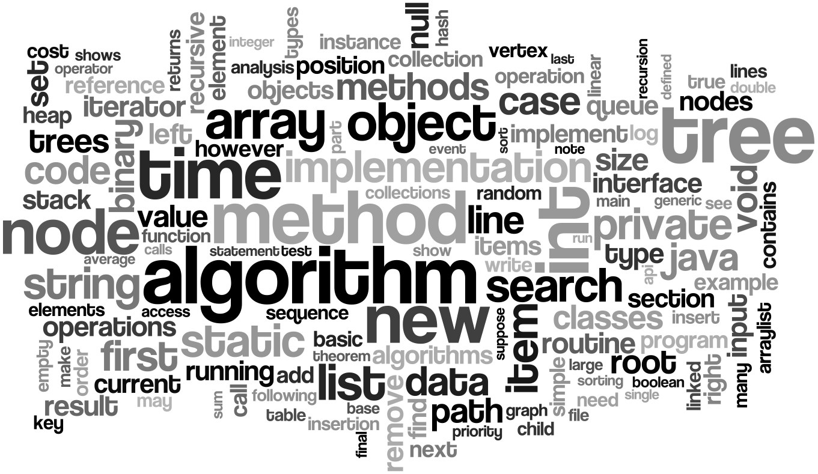
Lot of jargon

Slide 8
Basic Data Structures
Basic Data Structures
Linear Data Structures
Non-Linear Data Structures
Arrays
LinkedLists
Stacks
Queues
Trees
Graphs
Hash Tables

Slide 9
What data structure to use?
array
Linked list
queue
tree
stack

Slide 10
Course Learning Objectives - CLOs
01 | Demonstrate the use of basic linear data structures in problem solving
02 | Identify the best technique for searching / sorting keeping in view of their performance characteristics.
03 | Apply various Tree data structure and its associated algorithm to solve problems involving hierarchical data.
04 | Solve problems using Graph data structures and its associated algorithms involving real life relationships between different types of data.

Slide 11
Data structure operations
Def: A data structure is a way to store and organize data in order to facilitate access and modifications
Access and modifications includes
traversing
searching
inserting
deleting
sorting
merging
etc etc
Lets discuss, the impact of above operations on an array of large size

Slide 12
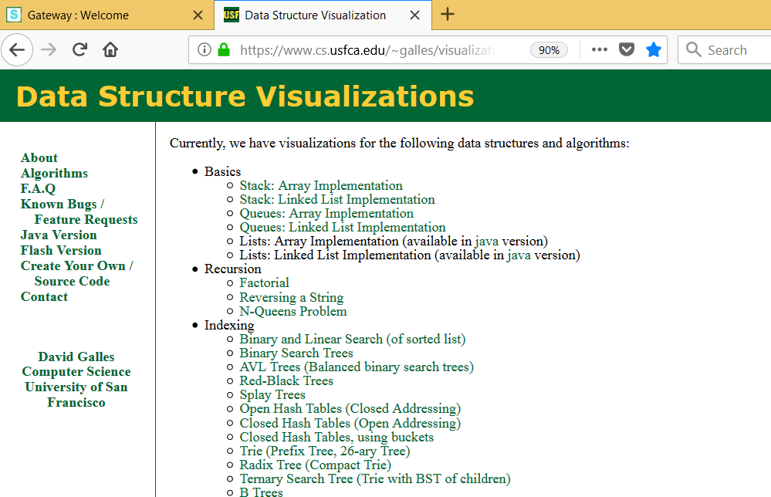
reference

